Slide 1
Buddhism
Basic Overview of Sangha
And
Core Doctrines

Slide 2
Refuge I: Buddha

Slide 3
Teaching:
Buddhism as world’s first missionary religion

Slide 4
Evolution of the Stūpa
Stūpa: Relics and Symbolic Presence of the Buddha
India Gandhara China Japan

Slide 5
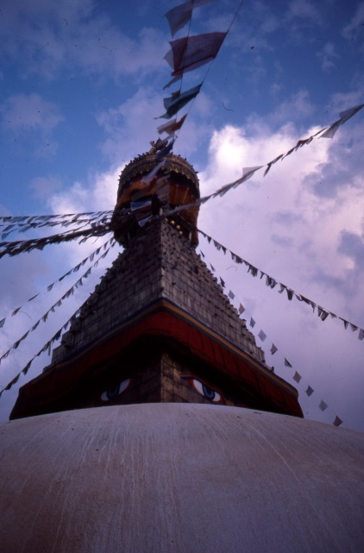
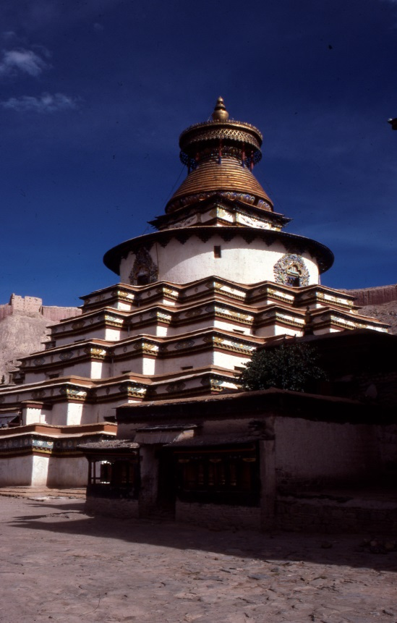
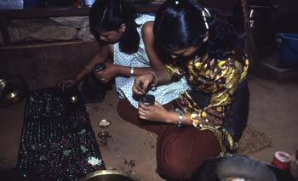
Stupas in the Himalayas

Slide 6
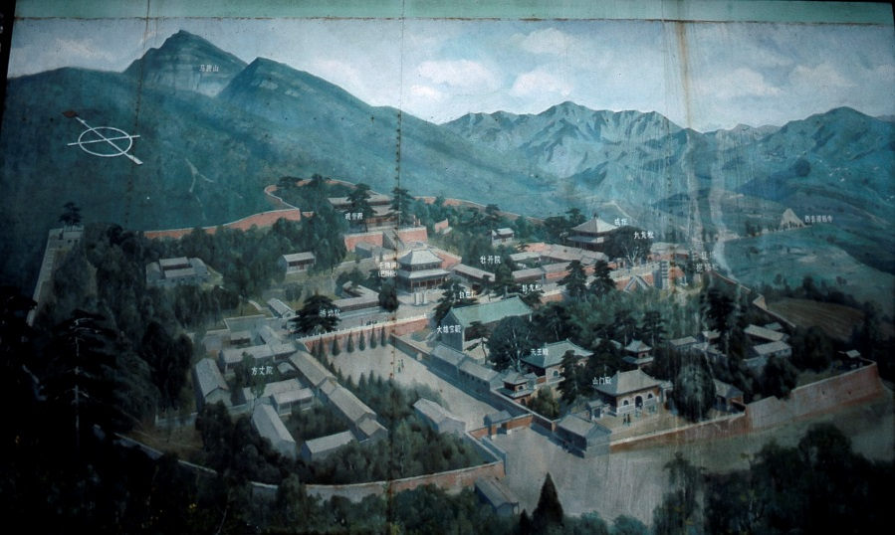
Refuge II: Sangha

Slide 10
Refuge III: Dharma [Teachings]

Slide 12
1. Duhkha
Reality in Samsara inevitably: Pain, Anguish, Suffering, Unsatisfactoriness

Slide 13
2. Trishna “thirst” “craving” “desire” Desire is the cause of suffering

Slide 14
3. Nirodha “cessation” This desiring, and hence suffering, can be ended.
How?
4. THE EIGHTFOLD
PATH…..

Slide 15
TRUTH 4: There is a Path [to end suffering]
Wheel:

Slide 16
8-FOLD PATH
Right Speech Right Effort
Right Action ➔ Right Mindfulness Right Views
Right Livelihood Right Concentration ➔ Right Intention
MORALITY ➔ MEDITATION ➔ PRAJÑĀ
shila dhyāna “insight” “wisdom” 
Nirvāna
% of population= 95%……………………………………………………….4.99%................................................................................................... .01%

Slide 17
Samsāra “the world” of rebirth and redeath

Slide 18
Gods in heaven
Human
Daityas
(angry spirits)
Preta
(hungry ghosts)
Animals, etc.
Purgatories

Slide 19
Hell for Adulterers & Bhutas (hungry ghosts)

Slide 20
Animals

Slide 21
Heaven and its downside: Asuras

Slide 22
Klesha-s “poisons” of embodied existence”
Lust, anger, delusion,

Slide 23
Karma[n] as natural spiritual law -- of cause and effect – determining destiny in Samsara

Slide 24
Note:
There are other causal contingencies that also affect life in samsara
e.g.
Material world (exterior and interior)
Gods and planets

Slide 25
Karma and its limits

Slide 26
Second Important Doctrinal Formula
THE THREE CHARACTERISTICS
of Existence
= What is Seen with prajñā

Slide 27
Mark #1: Suffering Mark #2 Impermanence

Slide 28
Suffering and Impermanence: Facing Embodied Existence

Slide 29
Mark #3: No-Self/ego/soul AN-ATMAN
“soul”
Experiences produce the construction of an imagined “self”; acts on this delusion/existential ignorance with desire, producing attachment and so bondage in samsara.

Slide 31
Buddhism as “Middle Way”
between
Extreme Sensual Pleasure
LIFE IN THE PALACE
and
Extreme Ascetic Practices
LIFE OF STARVATION

Slide 32
BASIC BUDDHIST FORMULA
“Calm the Mind, Discern the Real”
Desire [remedy: renunciation/detachment]
inflames inflames
Ignorance [remedy= meditation prajna]

Slide 33
Next week
Mahâyâna Buddhism

